Slide 1



Opportunity Zones
Tax Cuts and Jobs Act 2017
October 24, 2018

Slide 2

Overview
History of Opportunity Zone Program
Opportunity Zones – Qualifications & Designation
Opportunity Funds
Tax Benefits of Opportunity Zones
Possible Types of Investment

Slide 3
History – Investment in Opportunity Act
Drafted in 2016/Introduced Feb 2017
Bipartisan Legislation
Goal: To encourage private capital investment in economically distressed areas
Included in Tax Cuts and Jobs Act 2017 – December 22, 2017

Slide 4
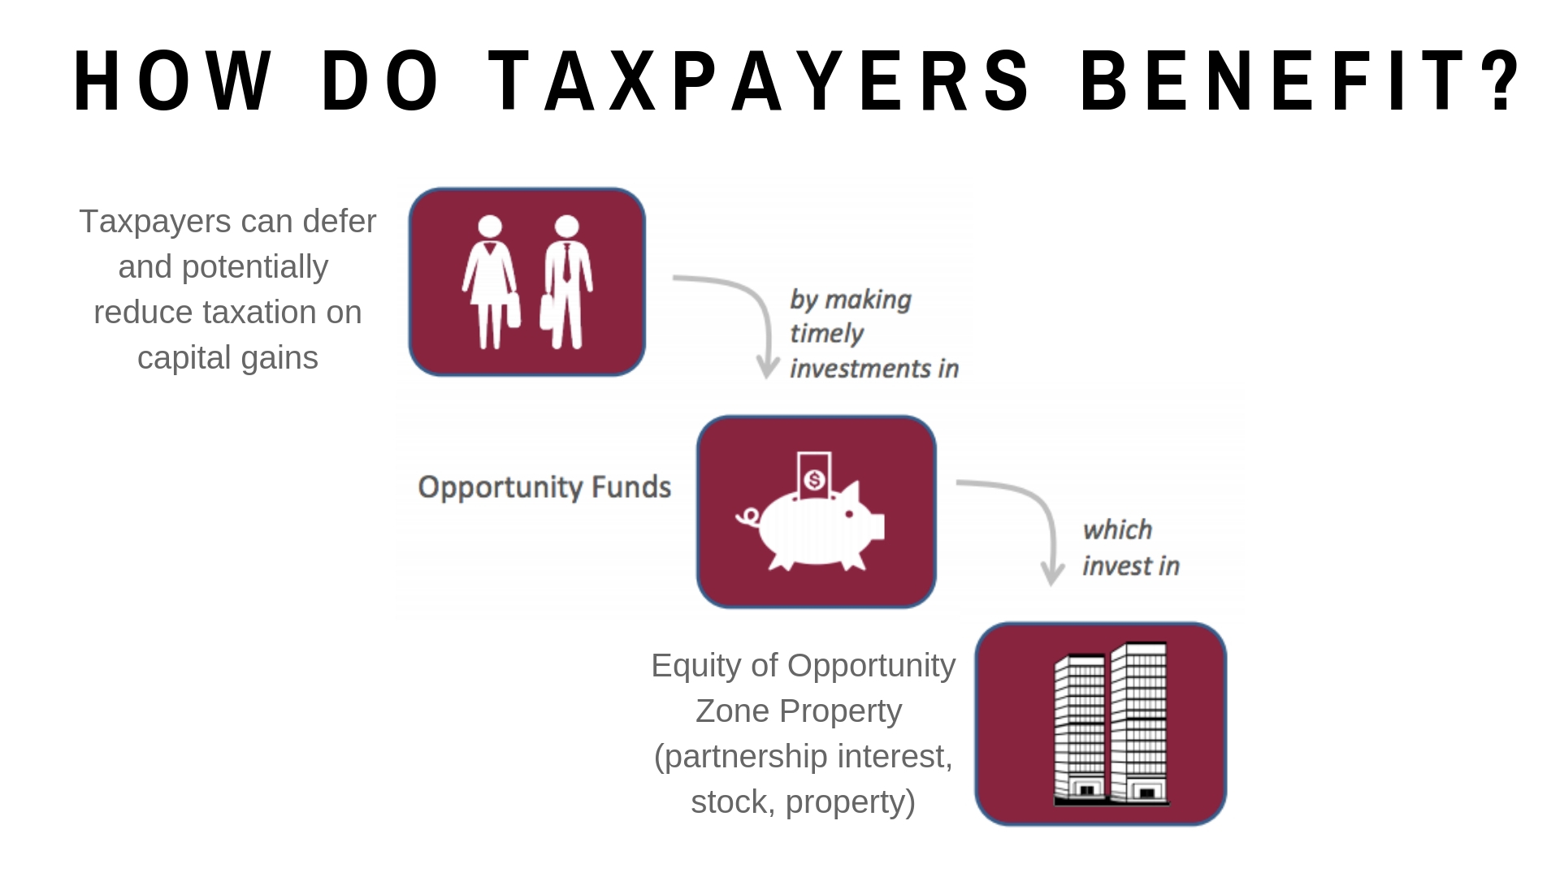
Opportunity Zones

Slide 5
Opportunity Zones
Qualifications
    2010 Census Tracts
    Eligible tracts – poverty rate (20%) or median family income (80%)
        500 eligible tracts in state of Colorado
    Governors designate 25% of eligible tracts within 90 days of when tax bill signed
        126 nominated in Colorado
    Dept. of Treasury had 30 days to certify OZs
    Locked in for 10 years
        8 areas designated in Pikes Peak region

Slide 6
Pikes Peak Region Opportunity Zones
Photo from Snell & Wilmer

Slide 7
Opportunity Funds
New private investment vehicle
Intermediary between investors and investment in an Opportunity Zone property
Requirements:
  Organized as Partnership, Corporation, LLC
  90% requirement
  Monthly penalty imposed for noncompliance of 90% requirement
  *Guidelines still being established by IRS & Treasury
Notes:
Define “property”
90% requirement + penalty
Opportunity Funds must hold at least 90% of assets in Opportunity Zone “Property” determined by the average of the percentage of OZ property held on:
The last day of the first 6 month period of the fund’s taxable year
AND the last day of the fund’s taxable year
Penalty = %shortfall x Federal Underpayment rate (Currently 5%)
Penalty proportionate to distributive share of each partner in fund partnership
No penalty if failure is due to “reasonable cause”
Guidelines – certification rules, rules for reasonable time to reinvest, rules to prevent abuse

Slide 8
Opportunity Funds
Certification
Self-Certification
Taxpayer completes a form
  Form 8996
  Completed form attached to taxpayer’s federal income tax return for taxable year
Appears to be no cap on number of Funds or amounts to be invested in a Fund
Notes:
Mixing of funds (capital gains and investment)
investment will be treated as 2 separate investments (capital gains subject to all OZ program laws)
Capital gains only
QOF will choose their first month of the taxable year in which will be treated as QOF, if month not chosen, first month will default to first month of taxable year. Last month of taxable year always testing date

Slide 9
Tax Incentives
3 Tax Incentive Benefits
1. Temporary Deferral of Capital Gains until 2026
- Applies to any capital gain from sale or exchange of any property to an unrelated person (within 180 days)
- $6 trillion of potential eligible capital
2. Partial Reduction of Deferred Gain (Tax Basis)
- Basis increased by 10% if investment in Fund held at least 5 years
- Basis increased by additional 5% if held at least 7 years (15% total possible)
3. Forgiveness of Additional (NEW) Gain
- If investment held for at least 10 years
- December 31, 2047
Notes:
(terminology) Roll over gains
New gains
“Phantom issues” – Dec 31, 2026 – issue for O Funds, date will need to be revisited

Slide 10
Tax Incentives: Temporary Deferral
Deferred capital gain: aggregate amount invested that does not exceed amount of gain generated
Applies to any individual, corporation, partnership, qualified settlement fund, disputed ownership fund, or trust
Sale or exchange of property to an unrelated person on or before December 31, 2026
Within 180 days of sale/exchange
Election made by taxpayer
Deferred gain is taxed either at investor’s sale of interest in Fund or on December 31, 2026
Amount of deferred gain subject to income tax is LESSER of amount of deferred gain OR fair market value of investment into Fund (Minus Basis)
Notes:
Perishability of Deferral Incentive – encourages investment soon
As we get closer to 2026, less opportunity to realize tax basis on capital gain

Slide 11
Tax Incentives

Slide 12
Example
Investor sells stock for $30M ($20M of capital gain) on July 1, 2018
Investor invests $20M in an Opportunity Fund on September 1, 2018
  Does not need to invest the entire $30M (Difference with 1031 exchange)
December 31, 2026:
  Investor’s tax basis in Fund was increased by $3M (15% of $20M)
    $2M on Sept. 1, 2023, and $1M on Sept. 1, 2025
    Investor has to pay tax on $17M capital gain from original capital gain from July 1, 2018
September 2, 2028:
  Investment in Fund has appreciated from $20M to $60M ($40M in potential gain)
  If the investment in the Fund is sold, then there is no taxable gain on the $40M of appreciation
Example by Snell & Wilmer

Slide 13
Opportunity Zone Property
Investments that constitute OZ Property are equity only (no debt):
-Indirect Investments: Equity investments in an OZ business
-Direct Investments: Direct purchase of OZ business property
After December 31, 2017

Slide 14
Opportunity Zone Business Property
Tangible property used in a trade or business
Original use for an existing building fully in OZ is not considered to have commenced with Fund
The OZ Business/Fund “substantially” improves the property
  30 month period
  Additions to basis that exceed adjusted basis of the property
  Land not part of “substantial improvement”
  Reasonable working capital safe harbor – 31 months
Special Rule: Tangible Property that ceases to be qualified OZ business property will be treated as qualified OZ business property for lesser of:
  5 years after the date which tangible property ceases to be qualified
  OR
  Date which tangible property is no longer held by qualified OZ business
Notes:
Opportunity Zone Businesses
A trade or business in which substantially all of the tangible property owned or leased by the taxpayer is OZ business property and:
-at least 50% of income derived from active conduct of trade or business
-substantial portion of intangible property used in active conduct of business
-less than 5% unadjusted basis of property is nonqualified financial property (cash, cash equivalent, long term loans)
If fund purchases an existing building located on land that is fully within OZ, original use of building does NOT commence, and land can never have original use in a OZ commencing with a Fund. Substantial improvement to building measured by funds additions to adjusted basis of building and taxpayer is not required to separately improve land that building sits on to qualify as substantial improvement.

Slide 15
Excluded Businesses
Can’t be a “sin business”
Golf Course
Country Club
Massage Parlor
Hot Tub Facility
Suntan Facility
Racetrack and other gambling facilities
Liquor/alcohol sales for consumption off premises

Slide 16
Indirect Investment
Issuance of stock or partnership interest in a qualifying entity after Dec 31, 2017, in exchange for cash
  Must be an original issuance
  Could be issued through an underwriter
Must be an OZ Business at time of issuance or is organized for the purpose of being an OZ business (for newly formed entities)
Must remain an OZ business for “substantially all” of Fund’s holding period.
Qualifying Entity: Corporation or Partnership in U.S., DC, or US Possession
Notes:
Domestic Corporation or Partnership, including LLCs

Slide 17

Some Possible Investments
Real Estate Development and Significant Rehabilitation in Opportunity Zones
Opening New Businesses and Startups in Opportunity Zones
Expansions of Businesses Already Within Opportunity Zones
Acquiring an Existing Business and Relocating it (with expansion) in an Opportunity Zone
Affordable Housing Projects
Notes:
Affordable housing

Slide 18
Opportunity Zones – Current Status
8,700 OZs designated
Guidance is still needed to address many issues
  Meaning of “substantially all” and “substantial portion”
  Interim gains
  “Reasonable period” to reinvest to avoid penalty
  Time period for Fund to invest cash received from investor
  Conduct leading to decertification
City’s Role
Building a Regional Investment Prospectus for the Greater Colorado Springs Region Opportunity Zones

Slide 19
Opportunity Zones – Current Status
How to use our Opportunity Zones
Match Making – projects and investors
Directing interested parties to Chelsea
Prospectus
  Projects and Properties
  Prospectus Involvement and Feedback
Advertising properties in Opportunity Zones
Who else should we be talking to?
Notes:
Looking for people to help with sites in all Ozs to work on teams for investment attraction
Which zones do people have most properties in/if any?

Slide 20
Resources
Office of Economic Development and International Trade:
https://choosecolorado.com/opportunity-zones/
CDFA: State of the States:
https://www.cdfa.net/cdfa/cdfaweb.nsf/ordredirect.html?open&id=201808_OZSoS.html
Economic Innovation Group: https://eig.org/opportunityzones
Opportunity360: Eligibility Tool:
https://www.enterprisecommunity.org/opportunity360/opportunity-zone-eligibility-tool
IRS FAQs: https://www.irs.gov/newsroom/opportunity-zones-frequently-asked-questions
Dept. of Treasury CDFI Fund: https://www.cdfifund.gov/pages/opportunity-zones.aspx
PolicyMap: https://www.policymap.com/maps
Novogradac & Company: https://www.novoco.com/resource-centers/opportunity-zones-resource-center
Fundrise Benefit Calculator:
https://fundrise.com/opportunity-fund?utm_source=google&utm_medium=cpc&utm_content=text-%2Bopportunity%20%2Bfund-b-fundriseofundlearn&utm_campaign=search-marketbuilding_opportunity_fundphrase-usa-20180705&gclid=EAIaIQobChMI0_idyv7Y3AIVBzJpCh113gh0EAAYASAAEgKNf_D_BwE
*City of Colorado Springs and Strategic Team Partners do not specifically endorse or confirm any resources, businesses, organizations, or individuals. If you have something helpful you would like us to share, please send it to us!

Slide 21
Questions?
Chelsea Gaylord cgaylord@springsgov.com | 719-385-6803
Notice: The purpose of this presentation is to provide meeting attendees general information about recent changes in the law that may impact their businesses and community. This presentation should not be considered legal or financial advice or opinion. We encourage you to speak with appropriate legal or financial counsel related to your specific needs.

